Slide 1
Data Visualization
簡廷因 Ting-Ying Chien
2016.01.04

Slide 2
Outline
Google Charts
Google Map API
Others tool

Slide 3
Google Charts

Slide 4
Introduction
Google Charts provides a perfect way to visualize data on the website.
All chart types are populated with data using the DataTable class

Slide 5
Line Chart
<!DOCTYPE html>
<html>
<head>
<meta charset = "utf-8">
<title>Line Charts</title>
<script type="text/javascript"
src="https://www.google.com/jsapi?autoload={
'modules':[{
'name':'visualization',
'version':'1',
'packages':['corechart']
}]
}"></script>
<script src="//code.jquery.com/jquery-2.1.4.min.js"></script>
<script type="text/javascript">
$(function(){
var data = google.visualization.arrayToDataTable([
['Year', 'Sales', 'Expenses'],
['2004', 1000, 400],
['2005', 1170, 460],
['2006', 660, 1120],
['2007', 1030, 540]
]);
var options = {
title: 'Company Performance',
curveType: 'function',
legend: { position: 'bottom' }
};
var chart = new google.visualization.LineChart(document.getElementById('curve_chart'));
chart.draw(data, options);
});
</script>
</head>
<body>
<div id="curve_chart" style="width: 900px; height: 500px"></div>
</body>
</html>
Data type :Array
Title : 標題
curveType: 曲線樣式
legend: 圖示

Slide 6
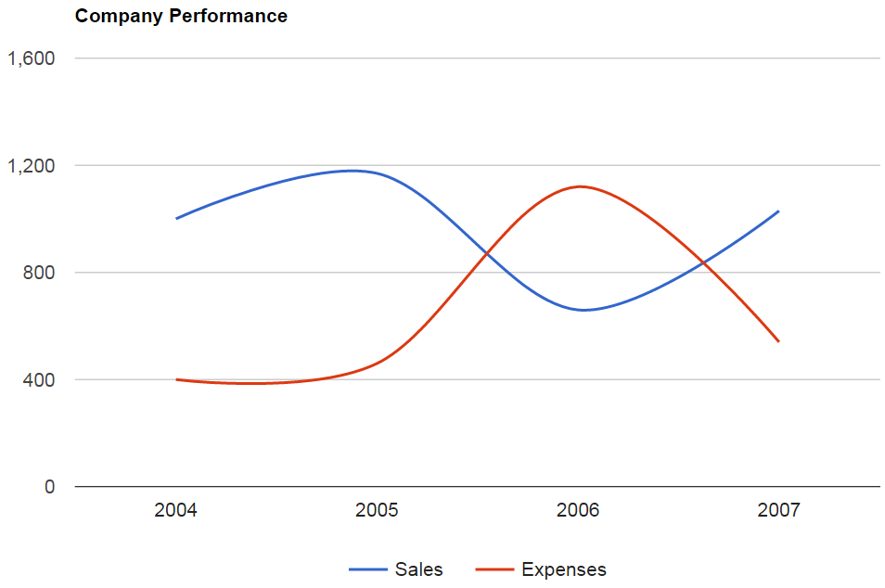
Line Chart

Slide 7
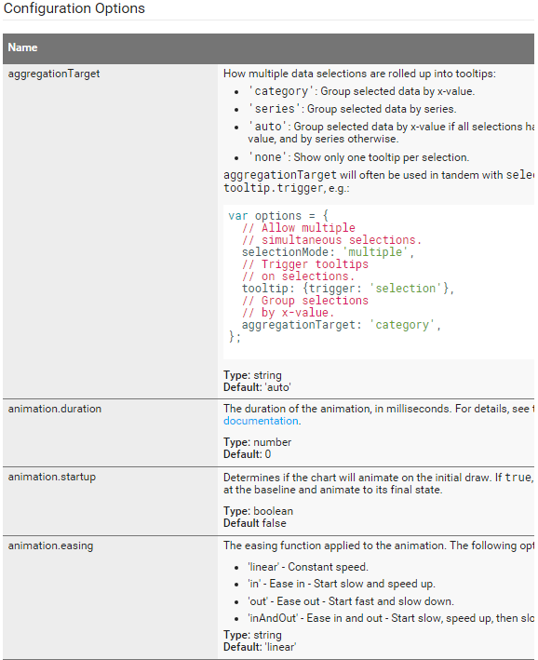
options
https://google-developers.appspot.com/chart/interactive/docs/gallery/linechart

Slide 8
Line Chart
<!DOCTYPE html>
<html><head>
<meta charset = "utf-8"><title>Line Charts</title>
<script type="text/javascript" src="https://www.google.com/jsapi"></script>
<script src="//code.jquery.com/jquery-2.1.4.min.js"></script>
<script type="text/javascript">
google.load('visualization', '1.1', {packages: ['line']});
$(function(){
var data = new google.visualization.DataTable();
data.addColumn('number', 'Day');
data.addColumn('number', 'Guardians of the Galaxy');
data.addColumn('number', 'The Avengers');
data.addColumn('number', 'Transformers: Age of Extinction');
data.addRows([
[1, 37.8, 80.8, 41.8],
[2, 30.9, 69.5, 32.4],
[3, 25.4, 57, 25.7],
[4, 11.7, 18.8, 10.5],
[5, 11.9, 17.6, 10.4],
[6, 8.8, 13.6, 7.7],
[7, 7.6, 12.3, 9.6],
[8, 12.3, 29.2, 10.6],
[9, 16.9, 42.9, 14.8],
[10, 12.8, 30.9, 11.6]
]);
var options = {
chart: {
title: 'Box Office Earnings in First Two Weeks of Opening',
subtitle: 'in millions of dollars (USD)'
},
width: 900,
height: 500,
axes: { x: { 0: {side: 'top'} } }
};
var chart = new google.charts.Line(document.getElementById('line_top_x'));
chart.draw(data, options);
});
</script>
</head>
<body><div id="line_top_x"></div></body>
</html>
dataColumn(型態,名稱) : 增加欄位
addRows : 增加值
title : 主標題
subtitle : 副標題
axes : 軸設定

Slide 9
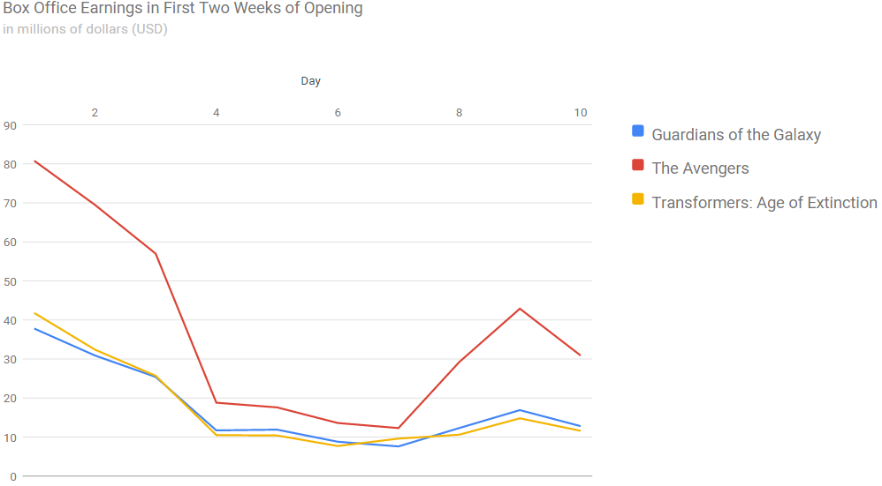
Line Chart

Slide 10
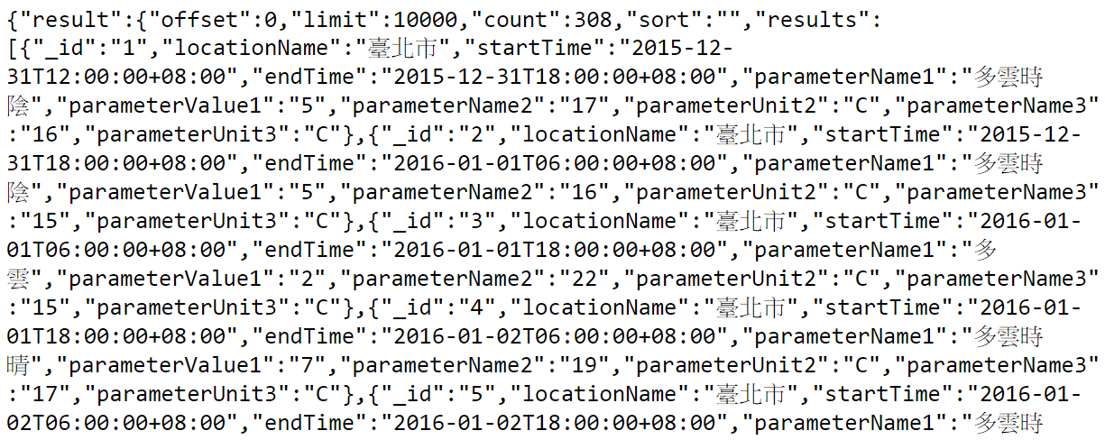
Line Chart + Ajax + JSON
<!DOCTYPE html>
<html><head>
<meta charset = "utf-8"><title>Line Charts</title>
<script type="text/javascript" src="https://www.google.com/jsapi"></script>
<script src="//code.jquery.com/jquery-2.1.4.min.js"></script>
<script type="text/javascript">
google.load('visualization', '1.1', {packages: ['line']});
function progress() {
var local = $("#location").val();
var data = new google.visualization.DataTable();
data.addColumn('string', 'Time');
data.addColumn('number', 'Temperture');
var options = {
chart: {
title: '一週氣溫',
subtitle: local
},
width: 900,
height: 500,
};
var chart = new google.charts.Line(document.getElementById('out'));
$.getJSON( "weather.php", function( out ) {
var results = out.result["results"];
$.each(results,function(i,item){
var time = item["startTime"];
time= time.substring(5,10)+" " +time.substring(11,16);
var value = parseInt(item["parameterName2"]);
var loc = item["locationName"];
if (loc == local){data.addRows([[time,value]]);}
});
chart.draw(data, options);
});
}
</script>
</head>

Slide 11
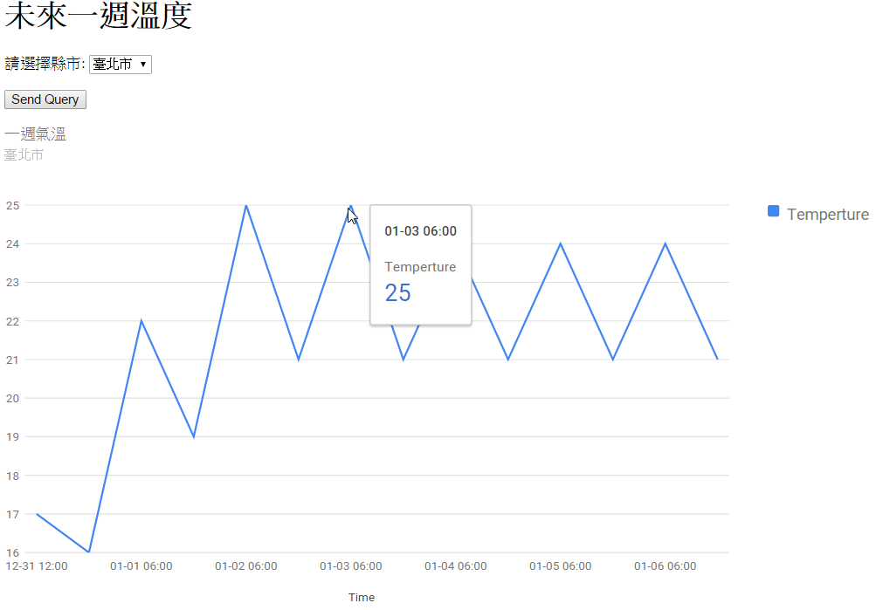
Line Chart + Ajax + JSON
<body>
<h1>未來一週溫度</h1>
<form method = "post" action = "#">
<p>請選擇縣市:
<select id = "location">
<option selected>臺北市</option>
<option>新北市</option>
<option>桃園市</option>
</select>
</p>
<p>
<input id = "submit" type="button" value = "Send Query" onclick="progress()"></p>
</form>
<div id="out"></div>
</body>
</html>

Slide 12
Line Chart + Ajax + JSON
weather.php
<?php
header("Access-Control-Allow-Origin: *");
$context = stream_context_create(array('http' => array('header' => 'Accept: application/json')));
$url = "http://data.taipei/opendata/datalist/apiAccess?scope=resourceAquire&rid=e6831708-02b4-4ef8-98fa-4b4ce53459d9" ;
$data = file_get_contents($url, false, $context);
print $data;
?>

Slide 13
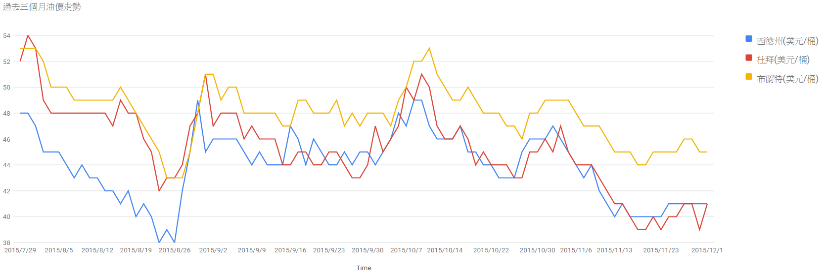
Exercise
過去三個月油價走勢
http://web3.moeaboe.gov.tw/ECW/populace/opendata/wHandOpenData_File.ashx?set_id=2

Slide 14
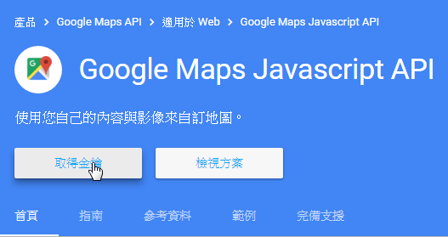
Google Map API
https://developers.google.com/maps/documentation/javascript/
Get private key

Slide 15
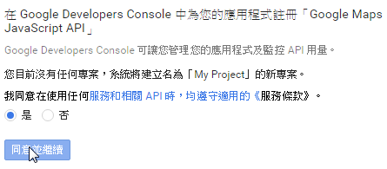
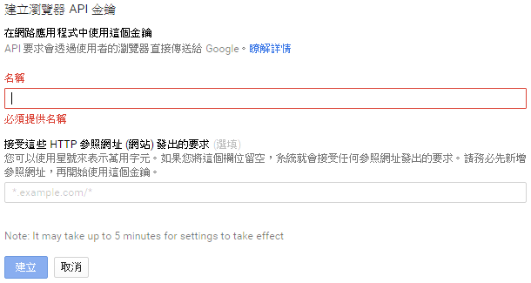
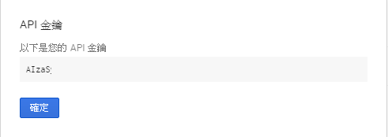
Google Map API
Get private key

Slide 16
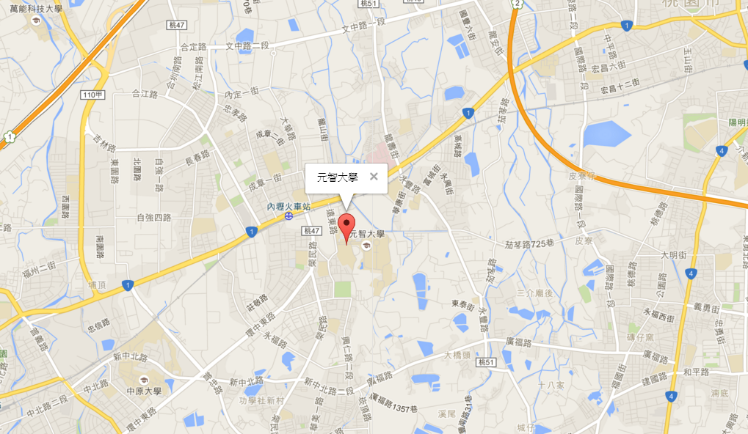
<!DOCTYPE html>
<html>
<head>
<title>Simple Map</title>
<meta name="viewport" content="initial-scale=1.0">
<meta charset="utf-8">
<script src="https://maps.googleapis.com/maps/api/js?key=API_KEY"></script>
<script src="//code.jquery.com/jquery-2.1.4.min.js"></script>
<script>
$(function(){
var map = new google.maps.Map(document.getElementById('map'), {
center: {lat: 24.9699054, lng:121.264305 },
zoom: 14
});
var myCenter=new google.maps.LatLng(24.9699054,121.264305);
var marker=new google.maps.Marker({
position:myCenter,
});
marker.setMap(map);
var infowindow = new google.maps.InfoWindow({
content:"元智大學"
});
infowindow.open(map,marker);
});
</script>
<style>
html, body {
height: 100%;
margin: 0;
padding: 0;
}
#map {
height: 100%;
}
</style>
</head>
<body>
<div id="map"></div>
</body>
</html>
建map, 設定中心點
建立標記點
建立說明

Slide 17
Web Resource
http://www.w3schools.com/googleapi/default.asp
https://developers.google.com/maps/documentation/javascript/examples/

Slide 18
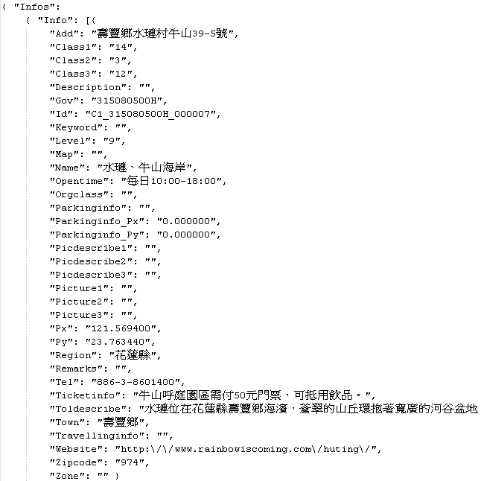
Google Map + Ajax
<!DOCTYPE html>
<html>
<head>
<title>Google Map + Ajax</title>
<meta name="viewport" content="initial-scale=1.0">
<meta charset="utf-8">
<script src="https://maps.googleapis.com/maps/api/js?key=API_KEY"></script>
<script src="//code.jquery.com/jquery-2.1.4.min.js"></script>
<script>
$(function(){
var map = new google.maps.Map(document.getElementById('map'), {
center: {lat: 24.9699054, lng:121.264305 },
zoom: 14
});
$.getJSON( "googlemap.php", function( out ) {
var results = out.Infos["Info"];
$.each(results,function(i,item){
var lat = item["Py"];
var lng = item["Px"];
var des = item["Toldescribe"];
var name = item["Name"];
var myCenter=new google.maps.LatLng(lat,lng);
var marker=new google.maps.Marker({
position:myCenter,
});
marker.setMap(map);
var infowindow = new google.maps.InfoWindow({
content:name+":"+des
});
google.maps.event.addListener(marker, 'click', function() {
infowindow.open(map,marker);
});
});
});
});
</script>
當標記點下去才顯示資訊

Slide 19
Google Map + Ajax
<style>
html, body {
height: 100%;
margin: 0;
padding: 0;
}
#map {
height: 100%;
}
</style>
</head>
<body>
<div id="map"></div>
</body>
</html>

Slide 20
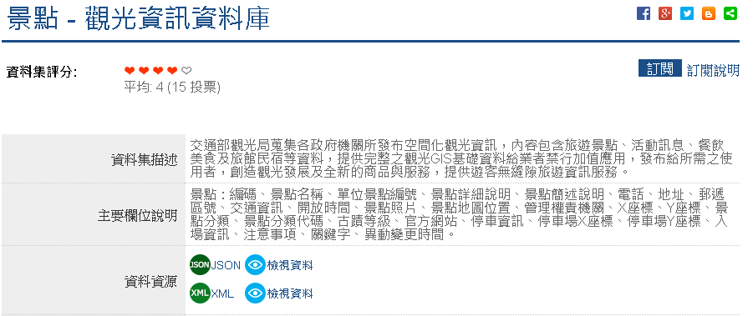
Google Map + Ajax
http://data.gov.tw/node/7777
googlemap.php
<?php
header("Access-Control-Allow-Origin: *");
$context = stream_context_create(array('http' => array('header' => 'Accept: application/json')));
$url = "http://gis.taiwan.net.tw/XMLReleaseALL_public/scenic_spot_C_f.json";
$data = file_get_contents($url, false, $context);
print $data;
?>

Slide 21
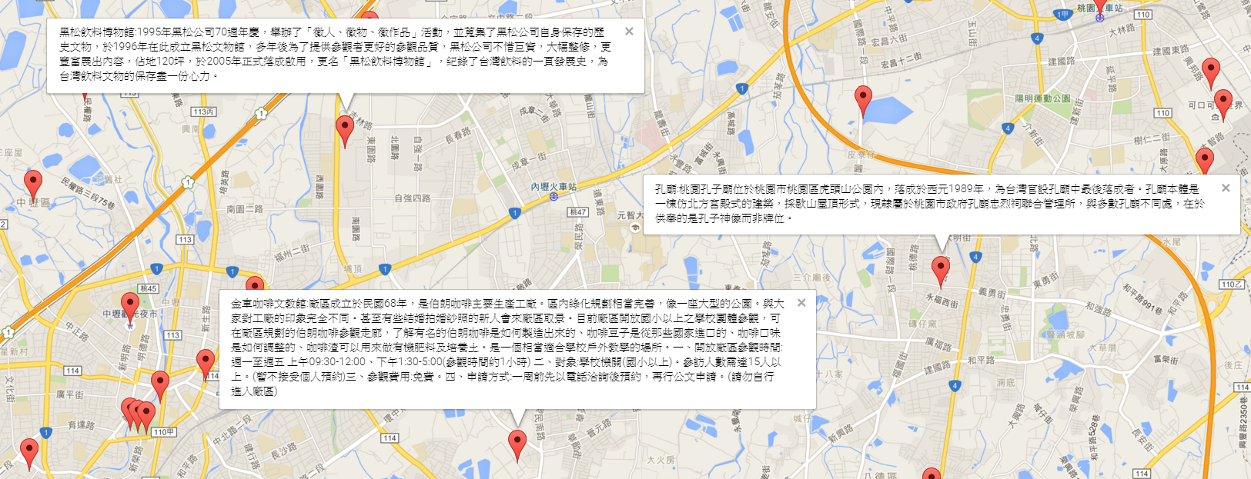
Google Map + Ajax

Slide 22
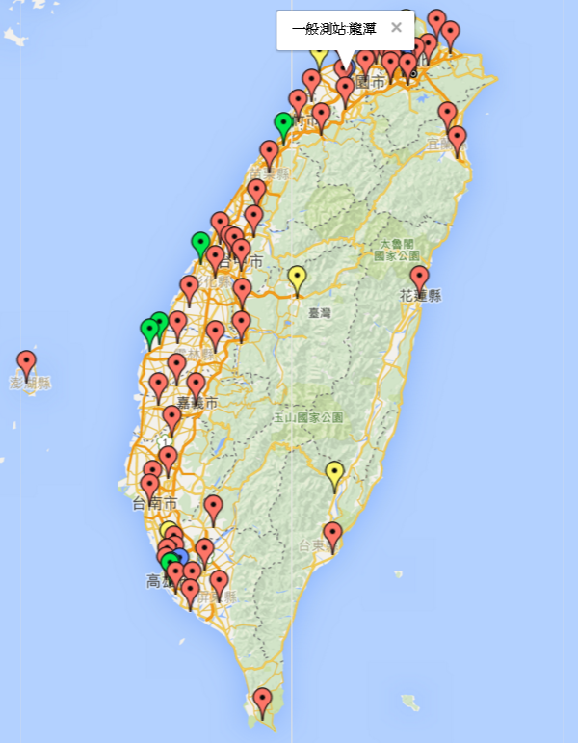
Exercise
利用google map顯示所有空汙監測站
http://data.gov.tw/node/6075
一般測站: 紅色
交通測站: 藍色
工業測站: 綠色
其他: 黃色
var png = "http://maps.google.com/mapfiles/ms/icons/red-dot.png";
var marker=new google.maps.Marker({
position:myCenter,
icon :png
});

Slide 23
Others tools

Slide 24
Tools
D3.js
http://d3js.org/
higtcharts / hightstock
http://www.highcharts.com/
leafletjs
http://leafletjs.com/
Others
http://selection.datavisualization.ch/

Slide 25
Q&A

